Slide 1

Data structure week Four
Contact Details:
Email: sobia.iftikhar@nu.edu.pk
GCR:

Slide 2
Content
List (Singly Linked List)
List (Doubly Linked List)
List (Circular Linked List)

Slide 3
Why do we need a Linked List?
You must be aware of the arrays which is also a linear data structure but arrays have certain limitations such as:
Size of the array is fixed
Array elements need contiguous memory locations to store their values.
Inserting an element in an array is performance wise expensive.
Similarly deleting an element from the array is also a performance wise expensive operation because all the elements after the deleted element have to be shifted left

Slide 4
These limitations are handled in the Linked List by providing following features:
Linked list allows dynamic memory allocation, which means memory allocation is done at the run time by the compiler and we do not need to mention the size of the list during linked list declaration.
Linked list elements don’t need contiguous memory locations because elements are linked with each other using the reference part of the node that contains the address of the next node of the list.
Insert and delete operations in the Linked list are not performance wise expensive because adding and deleting an element from the linked list does’t require element shifting, only the pointer of the previous and the next node requires change

Slide 5
Linked List Basics
A linked list is a linear data structure that stores a collection of data elements dynamically.
Nodes represent those data elements, and links or pointers connect each node.
Each node consists of two fields, the information stored in a linked list and a pointer that stores the address of its next node.
The last node contains null in its second field because it will point to no node.
A linked list can grow and shrink its size, as per the requirement.
It does not waste memory space.

Slide 6
Use of Linked list
In the implementation of Stacks and Queues.
Image viewer – Previous and next images are linked and can be accessed by the next and previous buttons.
Previous and next page in a web browser – We can access the previous and next URL searched in a web browser by pressing the back and next buttons since they are linked as a linked list.
Music Player – Songs in the music player are linked to the previous and next songs. So you can play songs either from starting or ending of the list.
Hashing(during chaining)

Slide 7
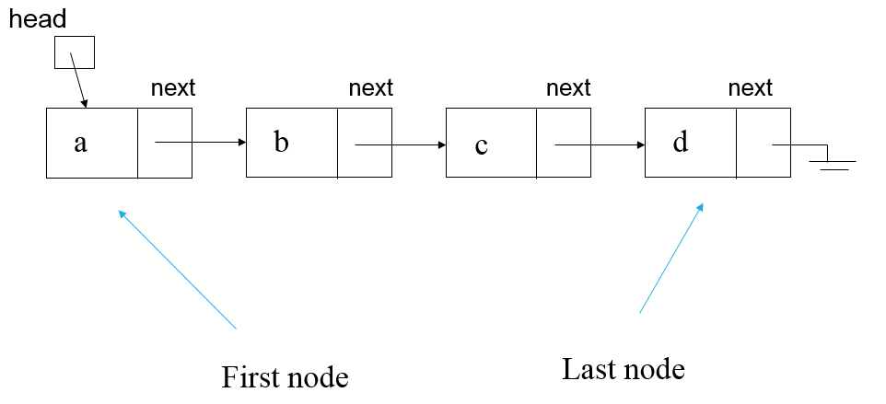
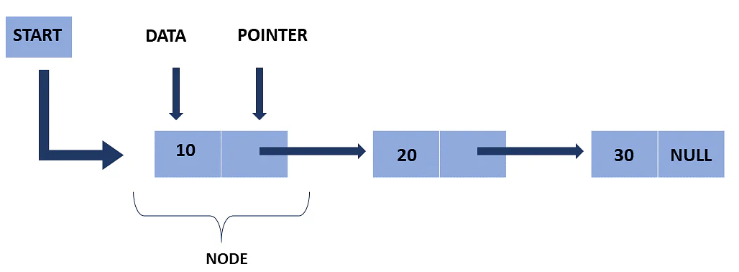
Representation of a Linked List
Linked list is a particular list of some data elements linked to one other. In this every element point to the next element which represents the logical ordering. Each element is called a node

Slide 8
Empty List
Empty Linked list is a single pointer having the value NULL.
head = NULL;
head

Slide 9
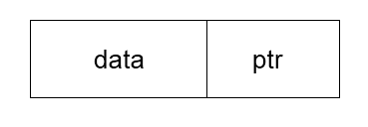
Linked List Basics
Each node has (at least) two fields:
Data
Pointer to the next node
As you know for storing address, we have a unique data structures called pointers. Hence the second field of the list must be a pointer type.

Slide 10
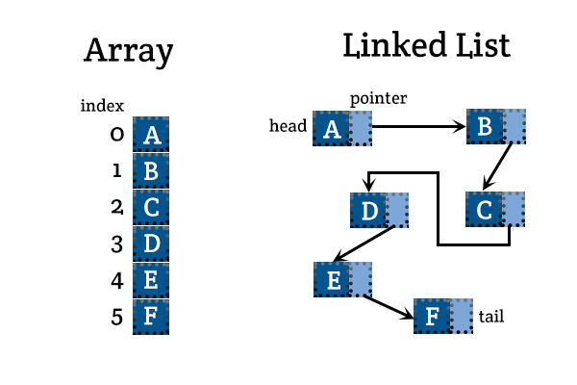
Linked List vs. Array
In a linked list, nodes are not necessarily contiguous in memory (each node is allocated with a separate “new” call)
Compare this to arrays which are contiguous
Array
head
Linked List
NULL

Slide 11


Linked List vs. Array
The time required is therefore constant. Thus, the time complexity for accessing (writing or reading) a particular element of an array is: o(1)
Advantages of Arrays
Can directly select any element
No memory wasted for storing pointers
Disadvantages of Arrays:
Fixed size (cannot grow or shrink dynamically)
Need to shift elements to insert an element to the middle
Memory wasted due to unused elements
Advantages of Linked Lists:
Dynamic size (can grow and shrink as needed)
No need to shift elements to insert into the middle
Size can exactly match the number of elements (no wasted memory)
Disadvantages of Linked Lists
Cannot directly select any element (need to follow ptrs)
Extra memory usage for storing pointers
In a linked list, in contrast, we can only access the first element directly. For all others, we have to follow the list node by node until we reach the desired element.
In the linked list example, we need more steps to reach the "p" than to get to the "a": O(n)

Slide 12
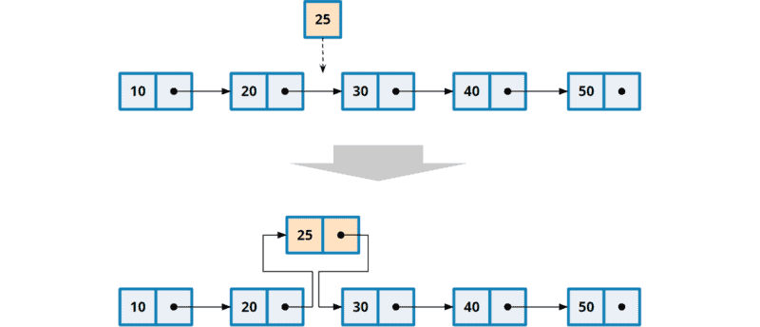
Adding or Removing an Element
Thus, the time complexity for inserting into and removing from a linked list is: O(1)
In a linked list, we can insert and remove nodes at any position. The cost is always the same, regardless of how long the list is and at which location we insert.

Slide 13
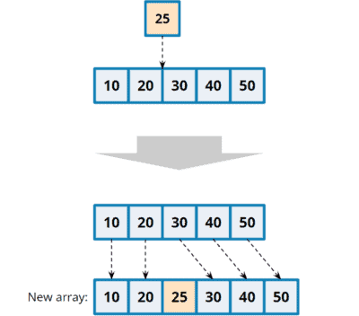
Adding or Removing an Element
An array cannot change its size. To insert or remove an element, we always have to copy the array into a new, larger or smaller array
The time required is proportional to the array length. The time complexity is, therefore: O(n)

Slide 14
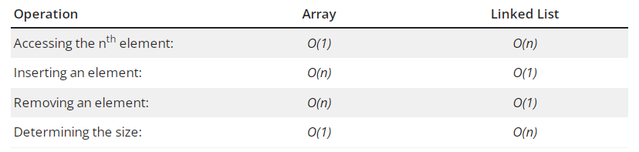
Time Complexity

Slide 15
Types of Linked List
Single Linked List
Double LL
Circular Linked List

Slide 16
Single Linked List
A singly linked list is a concrete data structure consisting of a series of nodes
Each node stores
Data item
Link to the next node
next
Data item
NODE
HEAD
CURRENT
TAIL
A
B
C
D
∅

Slide 17
Insertion
A
B
C
∅
X
2
A
B
C
∅
3
1
X
A
B
X
C
∅

Slide 18
Deletion
X
A
B
C
D
∅
1
A
B
D
∅
2
C
A
B
D
∅

Slide 19
Singly Linked List (cont..)
class Node
{
public:
int data;
Node next; //Self Referential
};
Node head = new Node();
Node second = new Node();
Node third = new Node();
head second third
| | |
| | |
+---+---+ +---+---+ +---+---+
| # | # | | # | # | | # | # |
+---+---+ +---+---+ +---+---+

Slide 20
Singly Linked List (cont..)
head.data = 1;
head.next = second;
second.data = 2;
second.next = third;
third.data = 3;
third.next = NULL;
head
|
|
+---+---+ +---+---+ +----+------+
| 1 | o----->| 2 | o-----> | 3|NULL |
+---+---+ +---+---+ +----+------+

Slide 21
SLL (Insert Node at Front)
Node insert_at_first(int data)
{
Node new_node = new Node();
new_node.data = data;
new_node.next = null;
}

Slide 22
SLL Traversal
void traverse()
{
while(temp.next != NULL)
{
cout<<temp.data<<endl;
temp = temp.next;
}
}

Slide 23
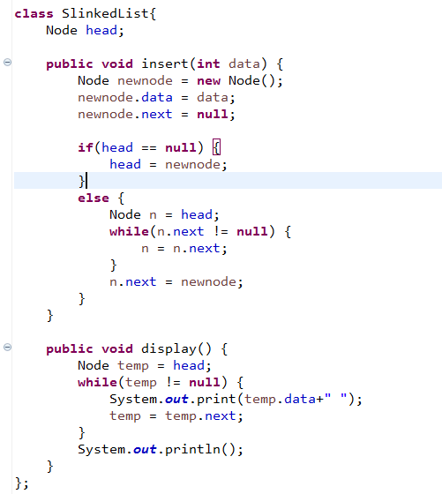
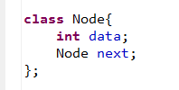
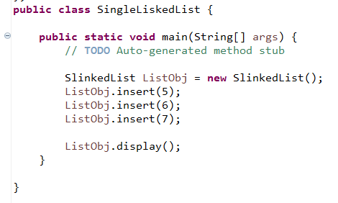
Implementation (creat,insert, traversal)

Slide 24
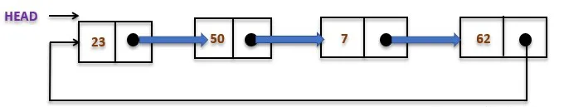
Circular Linked List
Pros: Any node can be a starting point. We can traverse the whole list by starting from any point. We just need to stop when the first visited node is visited again.

Slide 25
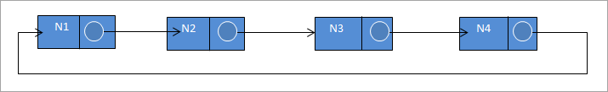
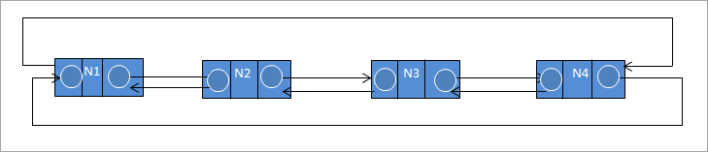
Types of Circular Linked List in Data Structure
Singly Circular Linked List
Doubly Circular Linked List
A circular linked list can be a singly linked list or a doubly linked list. In a doubly circular linked list, the previous pointer of the first node is connected to the last node while the next pointer of the last node is connected to the first node.

Slide 26
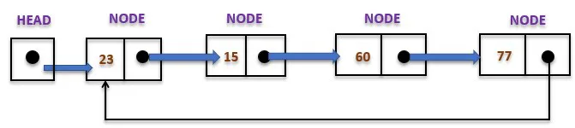
Example-(c-SLL)
The type of circular linked list whose every node has a pointer to its next node only is known as a singly circular linked list

Slide 27

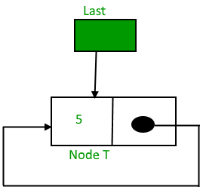
Insertion in an empty List
Initially when the list is empty, last pointer will be NULL.
After inserting a node T,

Slide 28
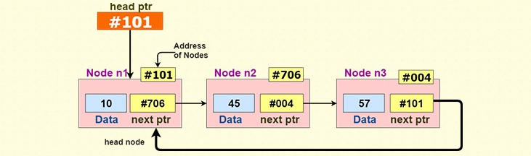
example

Slide 29
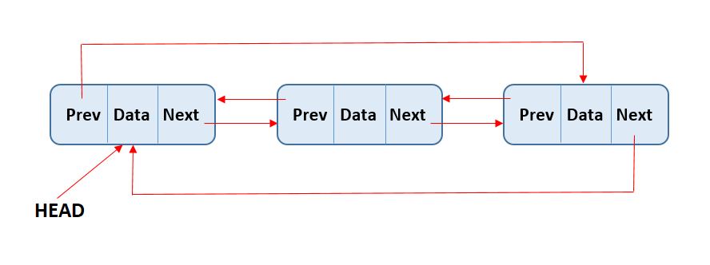
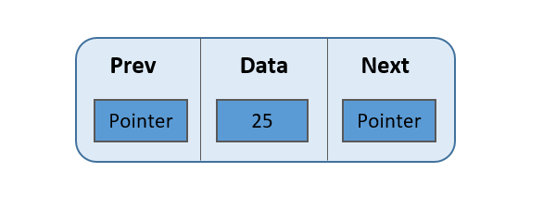
Circular Double linked list

Slide 30
Task
Construct a DLL consisting of 4 Nodes just
Display the value in forward and reverse manner both.
Delete the second value DLL
Repeat step - 01
Create Circular SLL and add five integer values {200,300,500,100}.
Perform following function on above SLL
insertion(40) at the beginning of circular Single list.
Delete 500 from SLL
Replace 100 by 700
Display function must be place after every modification

